Slide 1

HOTEL MANAGEMENT SYSTEM
Team:3 ASHLIN V RAJAN
NIBIMOL ABRAHAM
P JATHIN JHONY
RUBIN SABU

Slide 2
INTRODUCTION
Hotel Management System allows the customers to book rooms based on their necessity.
It allows the administrator to edit and view employee and customer details.
Hotel Management System allows the employees to view customer details and the history of previous customers .

Slide 3
OBJECTIVE
Employee can access customer booking details and history.
Customer can view room details and book rooms .
Admin can view and edit employee details and customer details.

Slide 4

FEATURES
Book Rooms
Staff Validation
Admin Validation
Add Staff
View Staff
Delete Staff
Add Customer
Display Customer
Delete Customer
Display Previous Customer

Slide 5
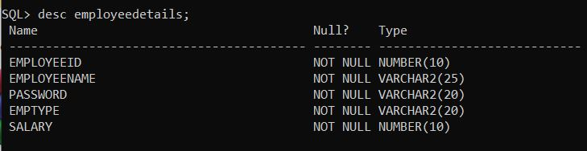
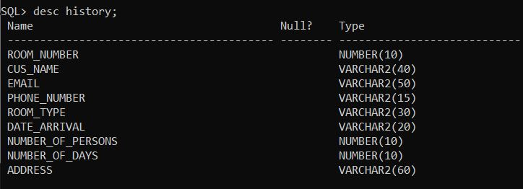
Database

Slide 6
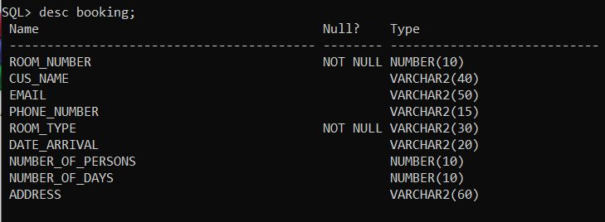

Slide 7
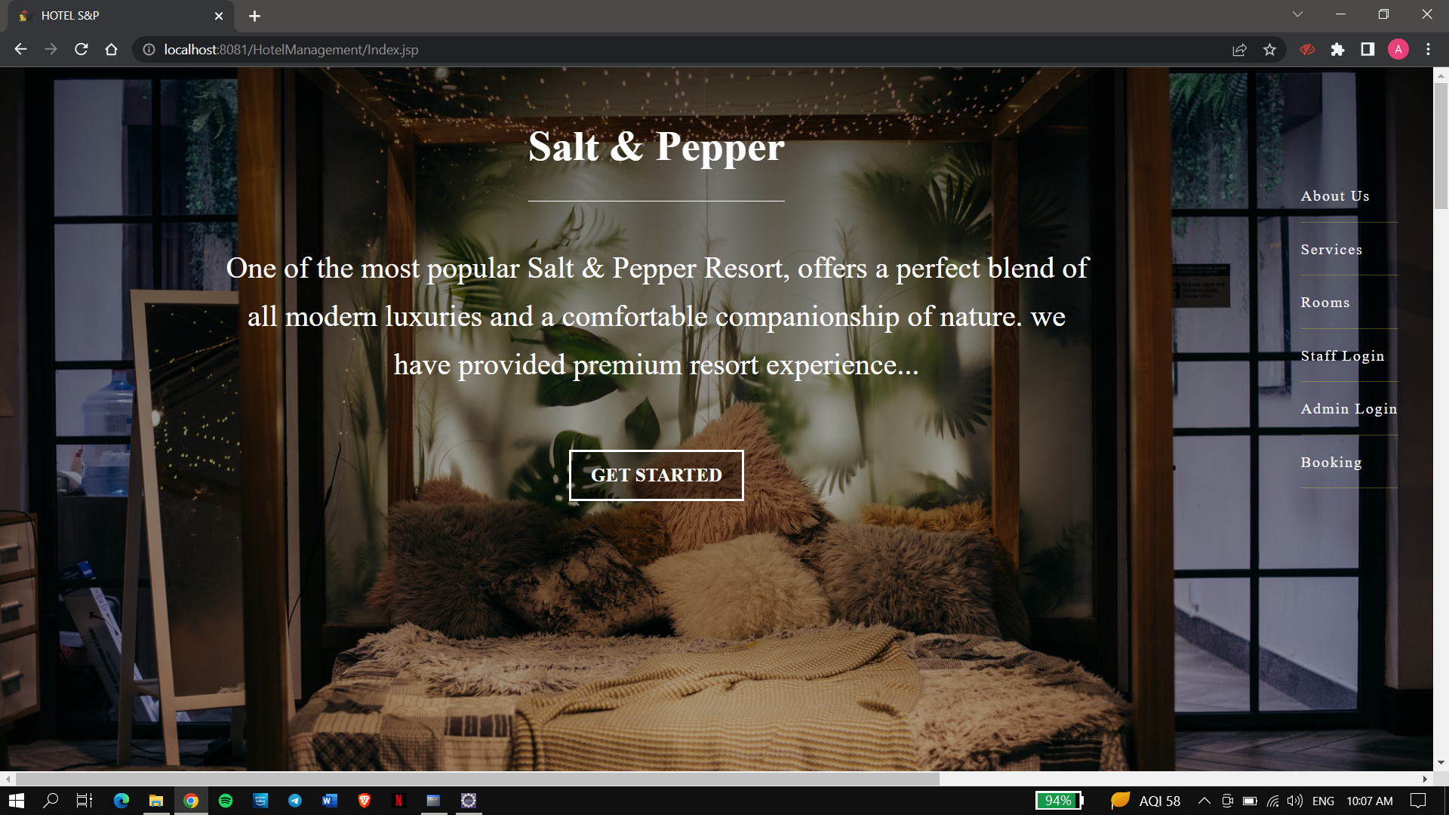
UI & Interface

Slide 8
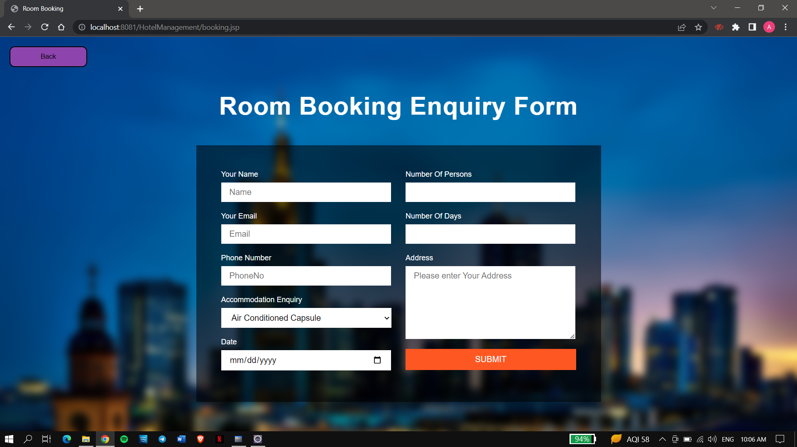
Room Booking Form

Slide 9
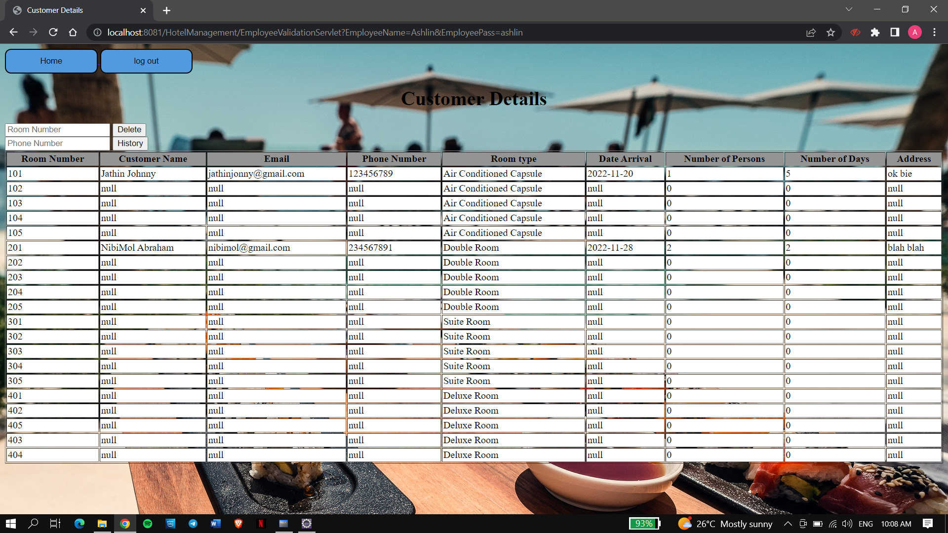
Customer Detils

Slide 10
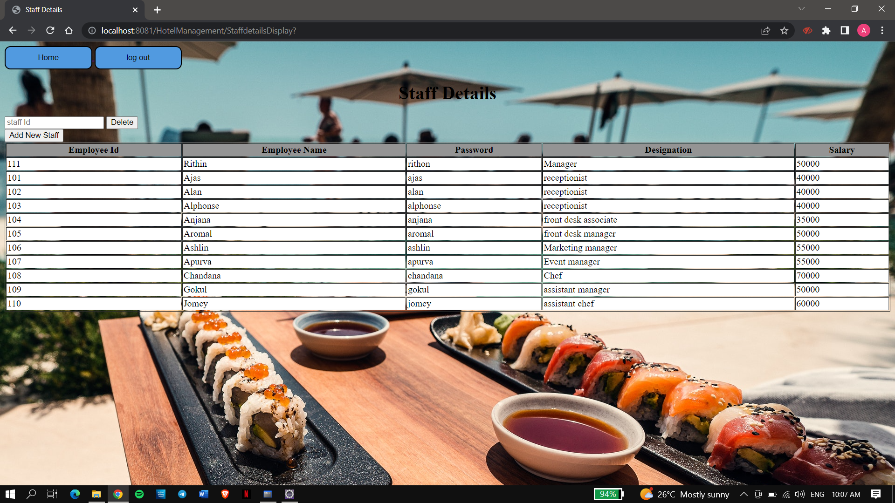
Staff Details

Slide 11

Tools:
❏JAVA
❏HTML
❏CSS
❏JSP
❏Servlet
❏Tomcat Server 7.0
Platforms:
❏Eclipse
❏Oracle Database

Slide 12
Conclusion
We completed a hotel management system in which customers can book rooms ,employee can access customer booking details and history, and admin can alter employee details and customer details

Slide 13
Thank You!!

